Slide 1
Introduction Ansible Roles

Slide 2
Agenda
What is Ansible Roles
Role components
How to use roles
Working with multi environments
Some advices

Slide 3
Introduction to Roles
What is Ansible Role?
In Ansible, the role is the primary mechanism for breaking a playbook into multiple files. This simplifies writing complex playbooks, and it makes them easier to reuse.
Roles provide a framework for fully independent, or interdependent collections of variables, tasks, files, templates, and modules.
Grouping content by roles also allows easy sharing of roles with other users.

Slide 4
Introduction to Roles
Roles are not playbooks.
Roles are small functionality which can be independently used but have to be used within playbooks.
Top-level playbooks are the bridge holding the hosts from your inventory file to roles that should be applied to those hosts.
Roles are ways of automatically loading certain vars_files, tasks, and handlers based on a known file structure.

Slide 5
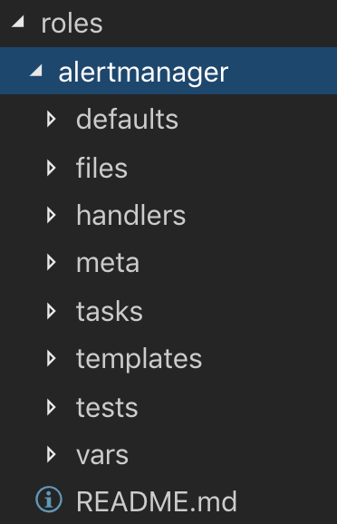
Roles Directory Structure
ansible-galaxy init alertmanager

Slide 6
Roles Directory Structure
- ansible/roles/alertmanager
./vars
./templates
./handlers
./files
./meta
./tasks
./defaults

Slide 7
Roles Directory Structure
When in use, each directory must contain a main.yml file, which contains the relevant content. The directory will look like this:
tasks - contains the main list of tasks to be executed by the role.
handlers - contains handlers, which may be used by this role or even anywhere outside this role.
defaults - default variables for the role.
vars - other variables for the role.
files - contains files which can be deployed via this role.
templates - contains templates which can be deployed via this role.
meta - defines some meta data for this role

Slide 8
Roles Directory Structure
Roles expect files to be in certain directory names.
Roles must include at least one of these directories, however it is perfectly fine to exclude any which are not being used.

Slide 9
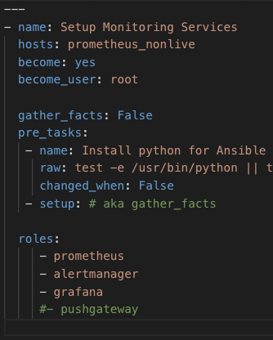
Roles - How to use
The classic (original) way to use roles is via the roles option for a given play:
Any copy, script, template or include tasks (in the role) can reference files in roles/x/{files,templates,tasks}/ without having to path them relatively or absolutely.

Slide 10
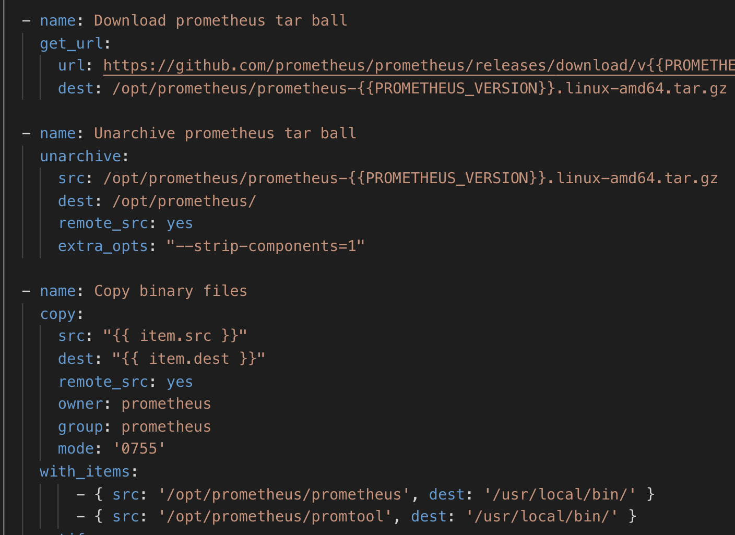
Roles - Tasks
Contains the main list of tasks to be executed by the role.

Slide 11
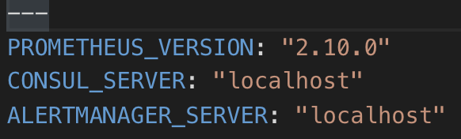
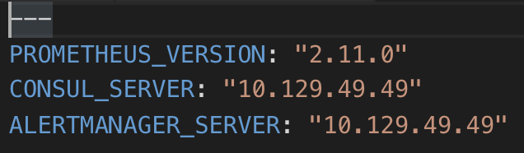
Roles - Defaults/Vars
defaults/main.yml
Contains variables for the role
Variables in vars override defaults
override
vars/main.yml

Slide 12
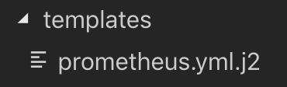
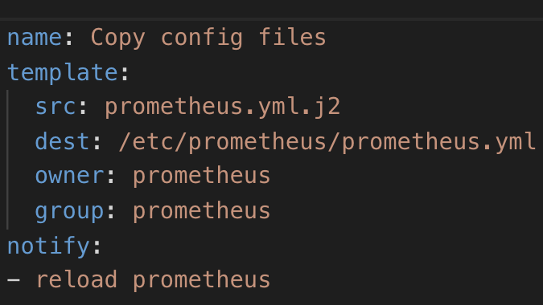
Roles - Templates
Contains templates which can be deployed via using module template in playbooks without declaring file path explicitly Variables in templates will be got from vars/defaults

Slide 13
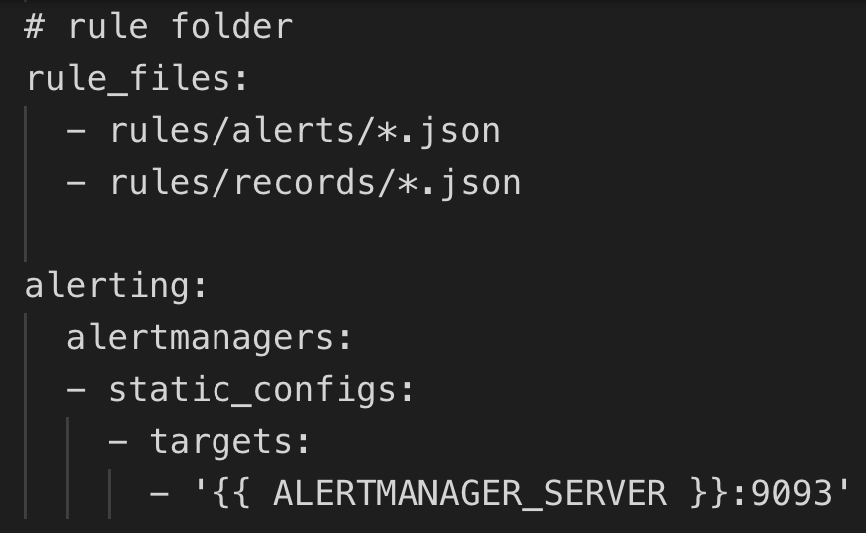
Roles - Templates
Contains templates which can be deployed via using module template in playbooks without declaring file path explicitly Variables in templates will be got from vars/defaults

Slide 14
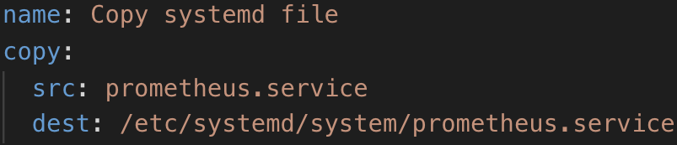
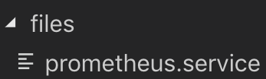
Roles - Files
Contains necessary files (binary, config, scripts…) for a role, which can be deployed via using module copy in playbooks without declaring file path explicitly

Slide 15
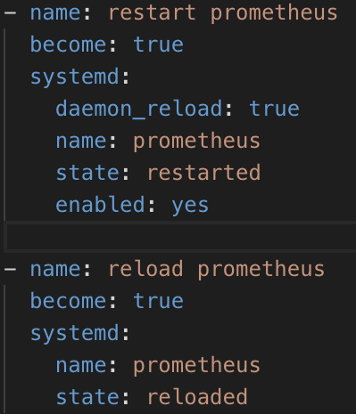
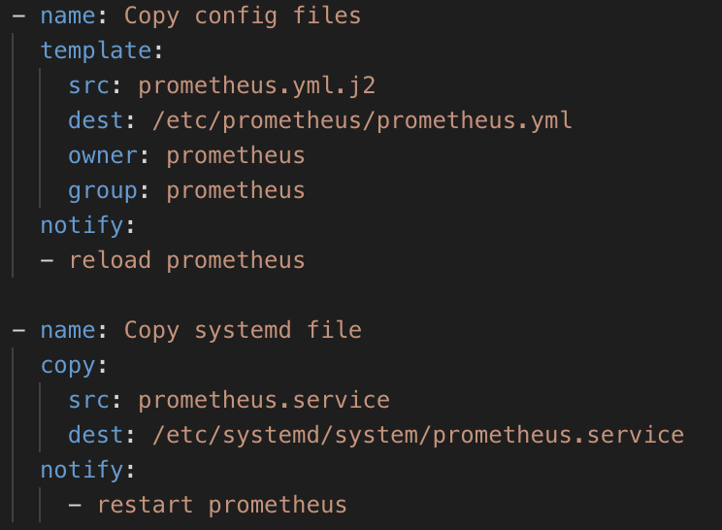
Roles - Handlers
Contains handlers, which may be used by this role or even anywhere outside this role by calling notify command

Slide 16
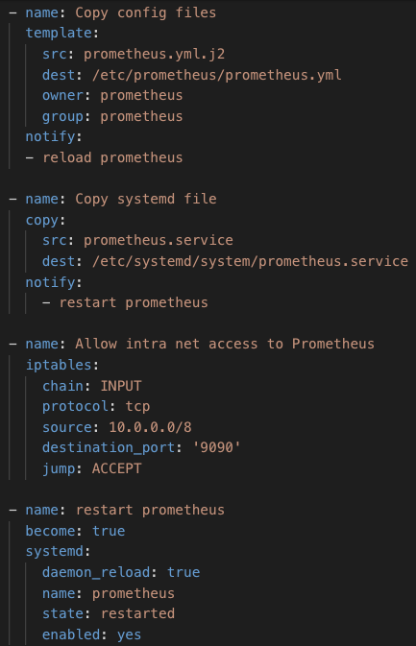
Roles - Handlers
Contains handlers, which may be used by this role or even anywhere outside this role by calling notify command
Maybe skipped when re-run the role

Slide 17
Roles - Handlers
We should use Handlers to handle triggers created by new config files

Slide 18
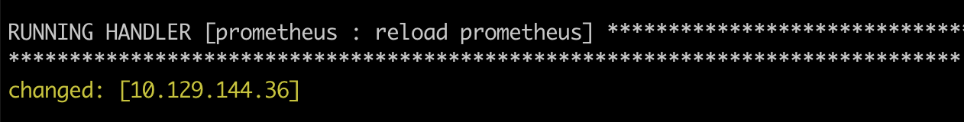
Roles - Handlers
Handlers are only fired when certain tasks report changes, and are run at the end of each play

Slide 19
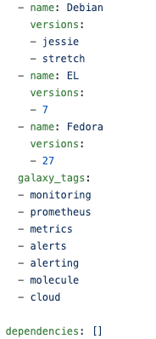
Roles - Meta
Contains some meta data and dependency list for the role
Not really necessary
May skip meta folder

Slide 20
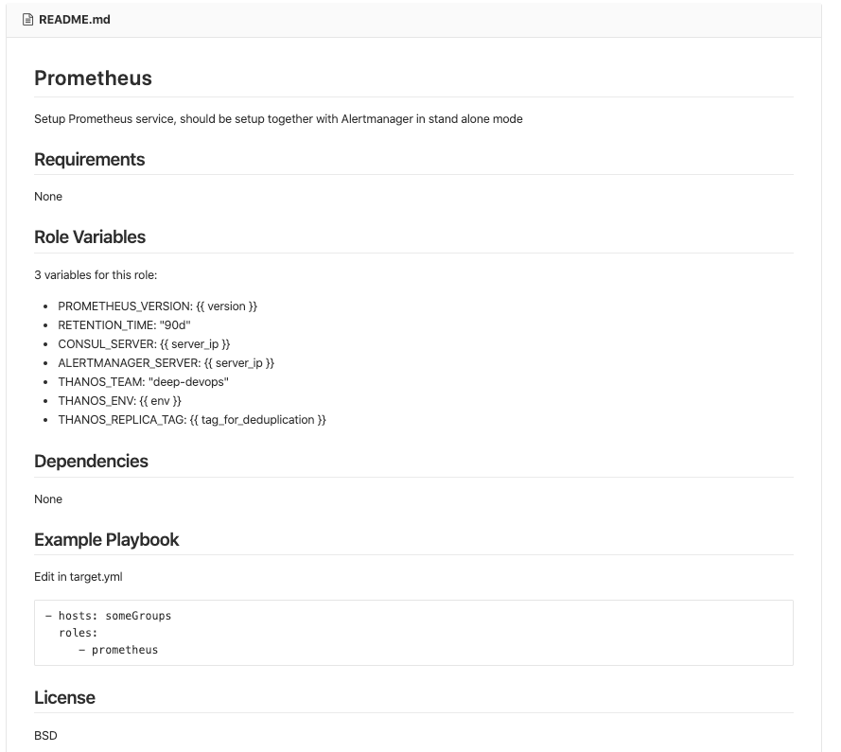
Roles - Readme
Describe role usage and how to use it. Each roles should have a Readme
ansible-galaxy init [role-name]
The format is auto-generated when init it with ansible-galaxy
Easier to share your roles for others to reuse

Slide 21
Role Search Path
Ansible will search for roles in the following way:
A roles/ directory, relative to the playbook file.
By default, in /etc/ansible/roles

Slide 22
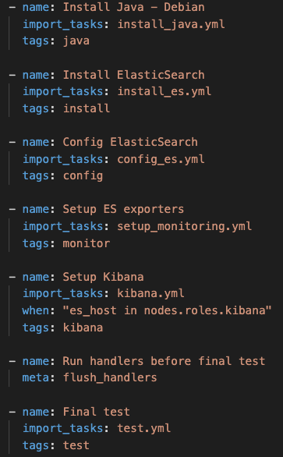

Tags
Give some tags to your plays :D

Slide 23
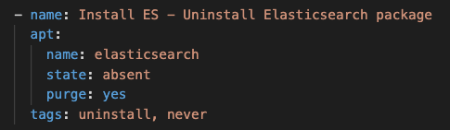
Tags
But be careful with your tags!! :(

Slide 24
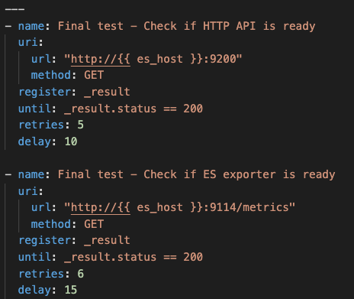
Testing Testing Testing!!!
Need to verify if all of your deployment works!!

Slide 25
group_vars vs vars vs default
Which comes firsts?
./roles/vars contains variables for the role.
Variables in vars have higher priority than variables in defaults directory.

Slide 26
Working with multi set of values
ansible-playbook -i hosts target.yml --extra-vars "@set_vars_1.json"
OR
ansible-playbook -i hosts target.yml -e "@set_vars_2.json"
Extra-vars will override parameters in vars/main.yml

Slide 27
Working with multi set of values
set_vars_1.json
{ "version": "1.1",
"env": "test" }
set_vars_2.json
{ "version": "1.3",
"env": "staging" }

Slide 28
Working with multi set of values
ansible-playbook -i hosts target.yml --extra-vars "@set_vars_1.yml"
OR
ansible-playbook -i hosts target.yml -e "@set_vars_2.yml"
Extra-vars will override parameters in vars/main.yml

Slide 29
Working with multi set of values
Set_vars_1.yml
--------------
version: "1.1"
env: "test"
Set_vars_2.yml
--------------
version: "1.3"
env: "staging"

Slide 30
group_vars vs vars vs default
Here is the order of precedence from least to greatest (the last listed variables winning prioritization):
command line values (eg “-u user”)
role defaults
inventory file or script group vars
inventory group_vars/all
playbook group_vars/all
inventory group_vars/*
playbook group_vars/*
inventory file or script host vars
inventory host_vars/*
playbook host_vars/*
host facts / cached set_facts
play vars
play vars_prompt
play vars_files
role vars (defined in role/vars/main.yml)
block vars (only for tasks in block)
task vars (only for the task)
include_vars
set_facts / registered vars
role (and include_role) params
include params
extra vars (always win precedence - most priority)
https://docs.ansible.com/ansible/latest/user_guide/playbooks_variables.html#ansible-variable-precedence

Slide 31
Things to consider
Your role ideally should:
Run fine in check mode
Not report changed if run for 2nd time (Idempotent!!!!)
Use “assert” to check that requirements are met
Template config files: should use validate before copying file
Trigger handlers when config files have changed
Provide sensible defaults for as many things as possible
Using version control

Slide 32
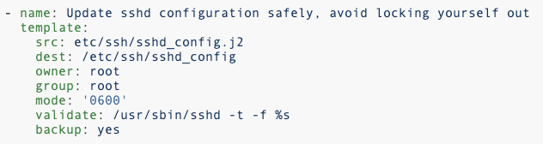
Validate templates

Slide 33
Check before running
ansible-playbook -i ansible/hosts ansible/target.yml --syntax-check
ansible-playbook -i ansible/hosts ansible/target.yml --check
Good at checking syntax, not so….. good at checking logic

Slide 34
Version Control
Use version control (Git)
Keep your playbooks and inventory file in git, and commit when you make changes to them.
This way you have an audit trail describing when and why you changed the rules that are automating your infrastructure.

Slide 35
Things to avoid
Avoid using shell/command module
there are plenty of better modules for the job
shell/command do not run in check mode by default
hard to control results
not idempotent (result may varies when run shell command multiple times)

Slide 36
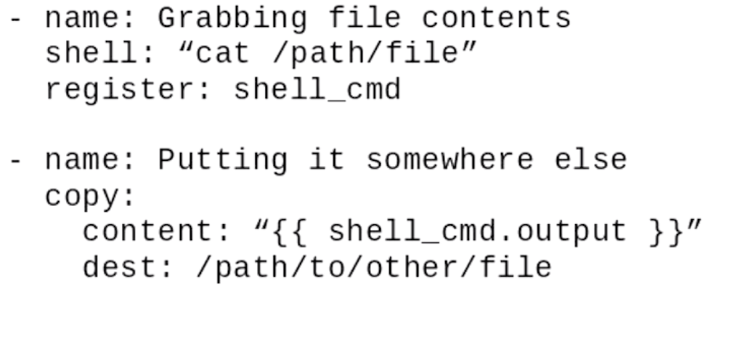
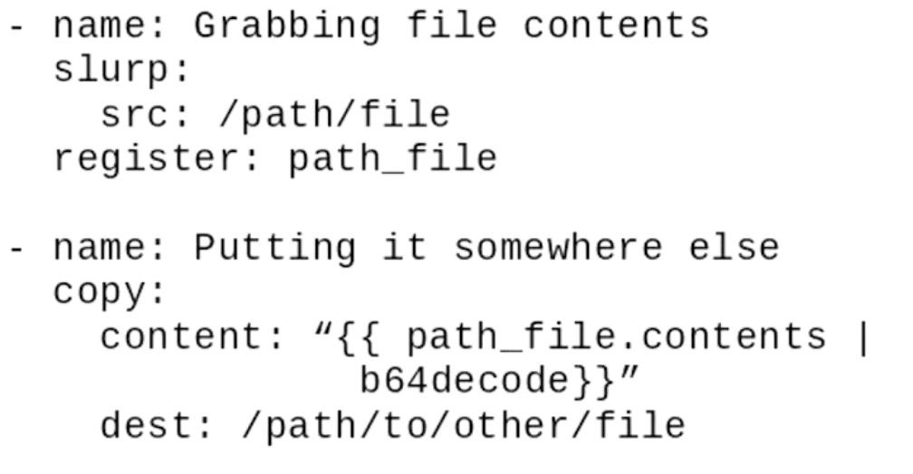
Alternatives to shell

Slide 37
Current problems
Instead of running scripts, is there better way to modify the configuration file of services?
Note: For distributed service, the configuration file on each nodes might differ a little bit. => vars files
Standard way to control the version of installed software?
My current way is to modify the version number in the download URL. => vars file
How to schedule multiple long-run ansible play tasks.
For example, I have two tasks, the first task runs 10 minutes, the second runs for 5 minutes. I want to run in the order task1, task2.

Slide 38
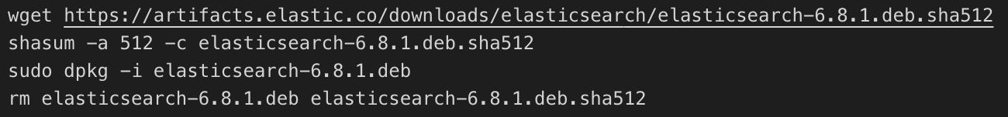
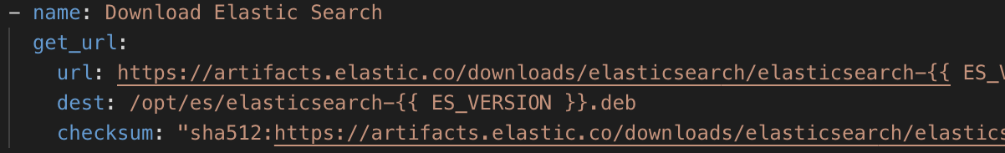
Examples
Before
After

Slide 39
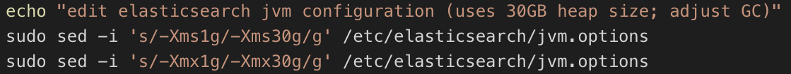
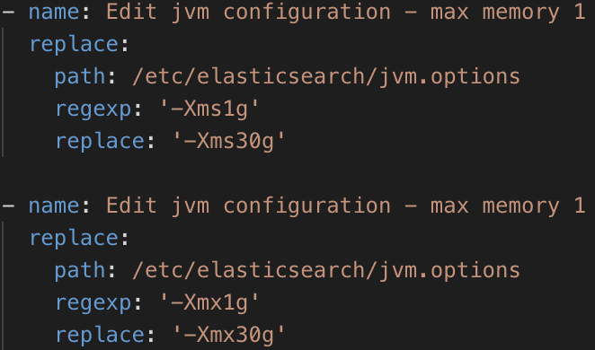
Examples
Before
After
Notes:
Consider

Slide 40
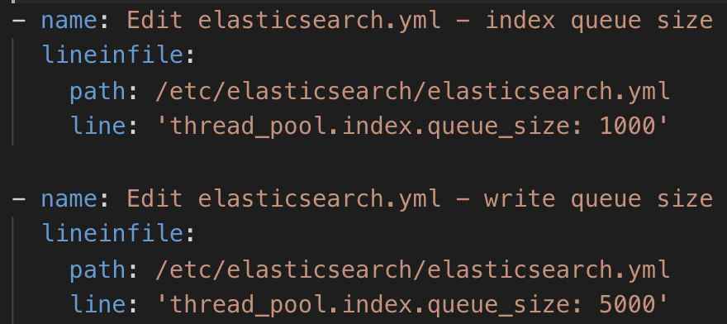
Examples
Before
After
Notes:
Consider using templates or files instead of replace and lineinfile module for service specific configurations

Slide 41
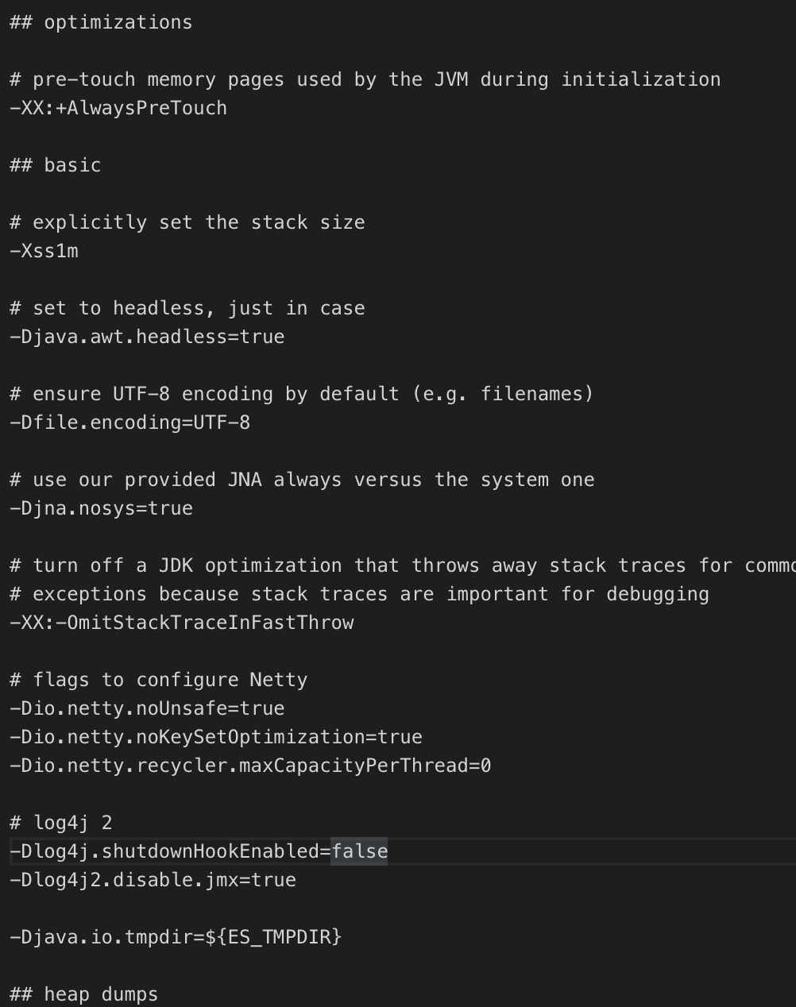
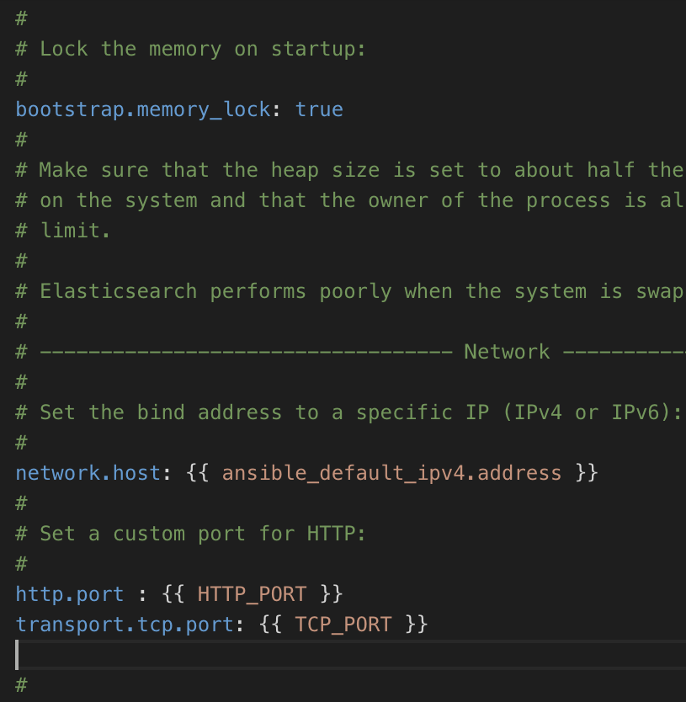
Examples
Notes:
Consider using templates or files instead of replace and lineinfile module for service specific configurations

Slide 42
Examples
Instead of:
hostIP=$(/sbin/ifconfig | grep "inet addr:10\.[0-9]\+\.[0-9]\+\.[0-9]\+" | awk '{print $2}' | cut -d':' -f2)
---
- hosts: localhost
connection: local
tasks:
- debug: var=ansible_all_ipv4_addresses
- debug: var=ansible_default_ipv4.address
Notes:
Ansible gert default IP

Slide 43
More examples

Slide 44
Q&A
Any questions? ^^

Slide 45
Reference
Playbooks Reuse Roles - Ansible Docs - A list of my personal Ansible Roles
Ansible Roles- Ultimate way to untangle your playbooks
Ansible Variable Precedence

